Slide 1
Digital Image Processing Solutions for Offside Recognition in Football
Pradipt Kalamkar
Vatsal Panchal
Ketan Wadekar
Project guide: Prof Krupi Saraf

Slide 2

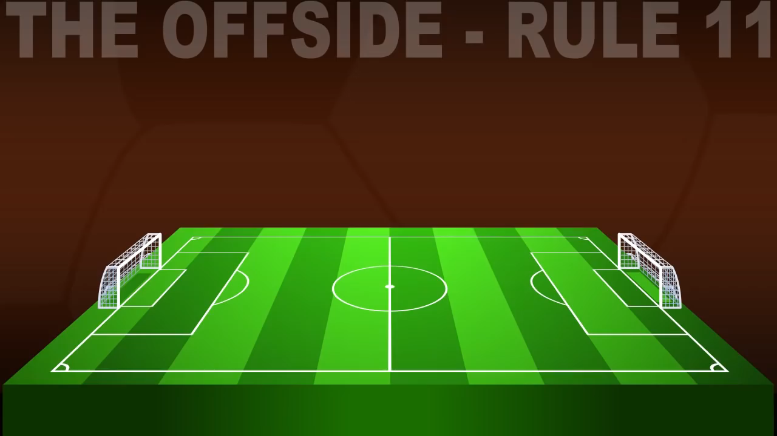
What is offside?

Slide 3
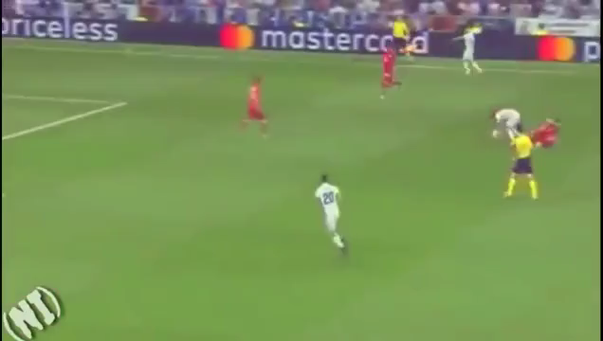
OKAY, NOW THAT WE KNOW WHAT OFFSIDE IS, DO YOU KNOW HOW CLOSE IS THE OFFSIDE CALL ?

Slide 4
Abstract
A solution for declaration of office event in soccer game based on digital image are Installed at stadium that send video pictures to a central processor system.
Based on image processing methods the ball, Players and referees group are specified by object’s morphological properties.
The other important topic in this paper is the way that how the system can realize the correct estimation of player’s location and ball by analyzing the video cam pictures in crowded areas.
To solve this problem, numeral computation and optical physics formulas are used to calculate the real coordinates of objects at soccer field.
There are a lot of prepared library methods to specify objects. Recognition players, ball and referees in the crowded pictures need to override modules. But firstly we need to get real coordinate’s location from visible pixels of each objects.

Slide 5
Introduction
Offside is a rule in soccer deducted with International soccer board influence on movement confine of players when they attack.
Offside law says that when an offensive would be in a situation that there are less than two foe players between him and the goal and gives a pass to teammate player, offside happens.
We know decisions to declare and not to declare offside is the most mistakable decision of referees in the soccer history.
No digital image processing system has presented to solve this problem yet and there is no system contoured that FIFA accepted it.

Slide 6
Literature survey
Researchers have done a lot of research to develop the idea of evaluating players’ position on the football field and getting a way to find out the events occurred in the field. Guoying Jin et al. have presented a video processing model called Hidden Markov Model to detect every event of a football match like offside. An experiment was done to find out the result and their method worked correctly as the model can find any event effectively. Their experiment worked perfectly as the games have primitive patterns like shoot, heading, jump etc. (Jin, 2004).
Tracking any object from the data given from the camera is also challenging. P. Mazzeo et al. have done an excellent work to classify players in multiple camera environments. They have used an unsupervised algorithm to generate class models of objects from different cameras. They also used a cumulative brightness transfer function to classify same colored objects like players in the same team or referees and they found a good result (Mazzeo, 2010). S. de Sousa et al. also have done a good research to detect an offside during the match.

Slide 7
Literature survey
This idea can also be used for tracking the players as players have less speed than a football. As their experiment worked correctly, it can be used to track the players on the field. The shadow is one of the most complex barriers to track players especially when a game occurs at night. J. Renno et al. have done a research to classify shadow to detect players perfectly. They used unsupervised learning procedure to get RGB from the images to distinguish the foreground and shadow.

Slide 8
Problem Definition
To increase the precision of the onside decision a system has been aimed that is called Tracking Technology in where quantify players positions and runs an algorithm to detect which players are onside or not.
To develop a system that recognises offside in a live soccer game by analysing the live stream or videos captured during the game by using digital video processing.

Slide 9
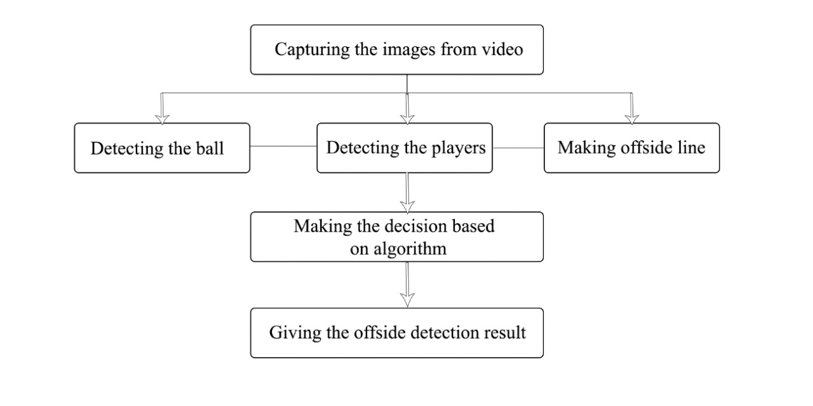

Slide 10
Future scope
The football matches have high value in the sports market and make a significant impact to an economy of a country.
Offside is an important rule for making fair competition for offence and defence to fight for getting and protecting the goal.
However since linesman sometimes cannot see important scenes for suggesting judgement to the referee due to limitation of the seeing ability of human, Afterimage, occlusion, and so on, the automatic system of linesman for detecting offside is urgently required.
To maintain the tempo of the game is one of the major aims of this project.

Slide 11
Technology stack
Dataset – Video clips from Football matches
IDE : Google Collab
Programming language : PYTHON
Libraries : OpenCV

